Slide 1

Rain Prediction –Classification

Slide 2

Introduction
Rainfall has a significant impact on society. Festivals, all sorts of activities, and sports matches are examples of events that could be heavily influenced by rainfall.
The goal of this analysis is to predict if it is going to rain the next day, based on the weather measures of the day before.
This creates a binary classification problem (1 = Rain and 0 = No Rain). The dataset consists of weather data in Australia over 10 years (1 Nov 2007 to 25 Jun 2017).
The dataset contains total 145460 rows and 23 columns
Rain Tomorrow is the target variable to predict. It means -- did it rain the next day, Yes or No? This column is Yes if the rain for that day was 1mm or more
Preprocessing Methods are implemented to clean and scale the data
Exploratory analysis done using different techniques

Slide 3
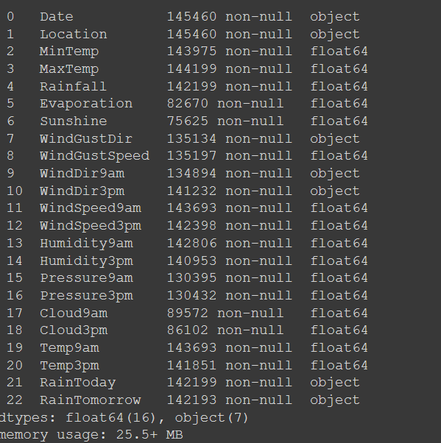
Data Information
The dataset contains total 145460 rows and 23 columns
‘RainTomorrow is our Target Variable
The variables Date, Location, WindsGustDir, WindDir9am, WindDir3pm, RainToday, and RainTomorrow are categorical
All Data Types are accurate according to Data information
Libraries used
Pandas Sklearn
Matplot.lib Seaborn

Slide 4
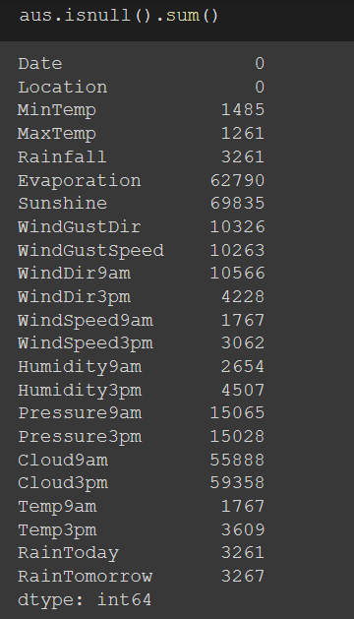
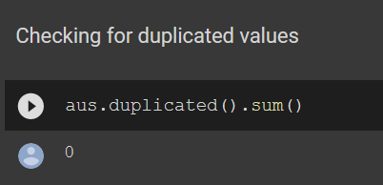
Data Cleaning
Checking Missing Values Checking Duplication
There is no duplicated values, so need further action needed
Inconsistencies
There is no inconsistencies in any of the values in columns
We can see there are missing values in data
Missinf values will be filled in preprocessing step

Slide 5
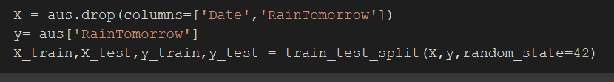
Preprocessing
Train Test split
Using train test split function data has been splitted into train and test data, also Date columns has been dropped s
Imputing Missing values
Numerical columns Missing values was been imputed with simple imputer mean method
Categorical columns missing values has been imputed with simple Imputer most frequent method
The variables Location, WindsGustDir, WindDir9am, WindDir3pm, RainToda
y, and RainTomorrow are categorical. I will use OneHot encoder to change it inot numerical type of variables to meet the criteria of the machine learning algorithms
Some of the variables are skewed (Rainfall, Evaporation, Pressure). I will standardize them. They need to be standardized because logistic regression is based on a linear relationship. Furthermore, the algorithms will perform better when they are scaled to a standard range,So I used Standardscaler to scale the data

Slide 6
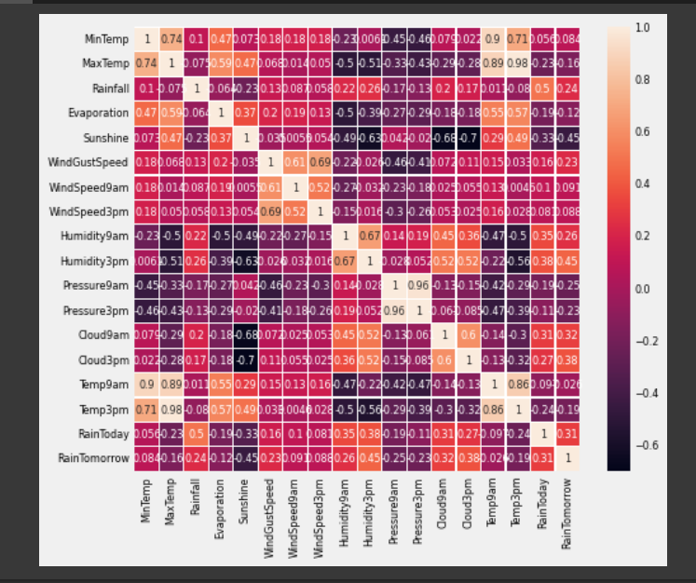
Exploratory Analysis
Corelation Matrix
We can see the Target 'RainTomorrow is corelated to Rain Today ,cloud 9 am, cloud 3 am, Humidity 3 pm and negatively corelated to sunshine, these corelated features makes significant roles in prediction

Slide 7
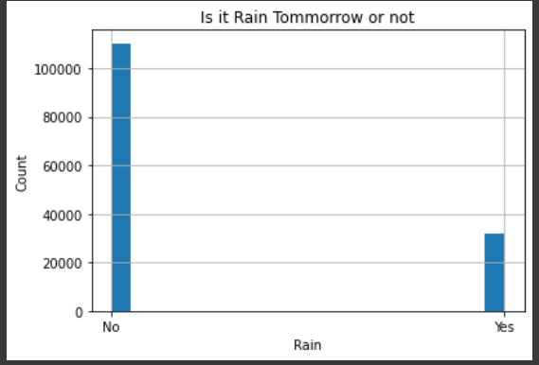
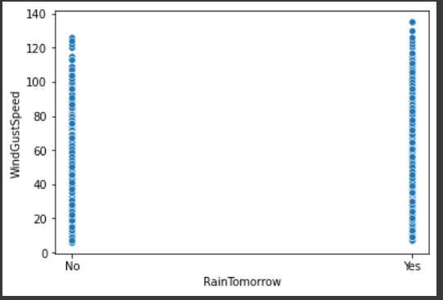
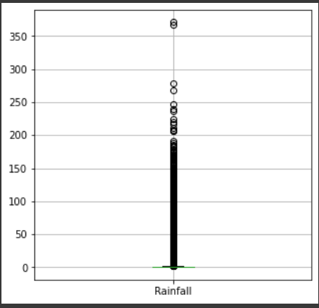
D
Does Is it going to rain tomorrow ? what are the odds
WindGust speed analysis
We can see when windgust speed is more chance when there is rain
The hist says says 'No' is more than 'Yes' so chance of rain will be less
we can see there are outliers in the distibution of rain fall there values after 371mm, so those days will be heavy rain,and most of the values including avg vale lies 2.71 mm
Distribution of Rainfall

